Slide 1
TabX
Inputting assistant for browsers
Notes:
We recently had an argument to change our name to velociraptor helicopter, Because TabX just wasn't cool enough.

Slide 2
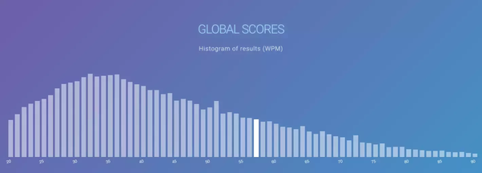
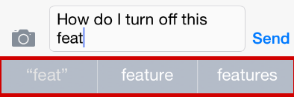
The World Needs a Writing Assistant
Notes:
Pre: Transition, We Want to fill a problem
First Click
Average typing speed in the US 40 WPM
Limits ability to use computer
Creates a gulf among users
Browsers are the hub of modern computer use
Next Click:
Phone Companies have already Identified this problem
Helped make the phone the most popular computer
Make it easier to use computers

Slide 3
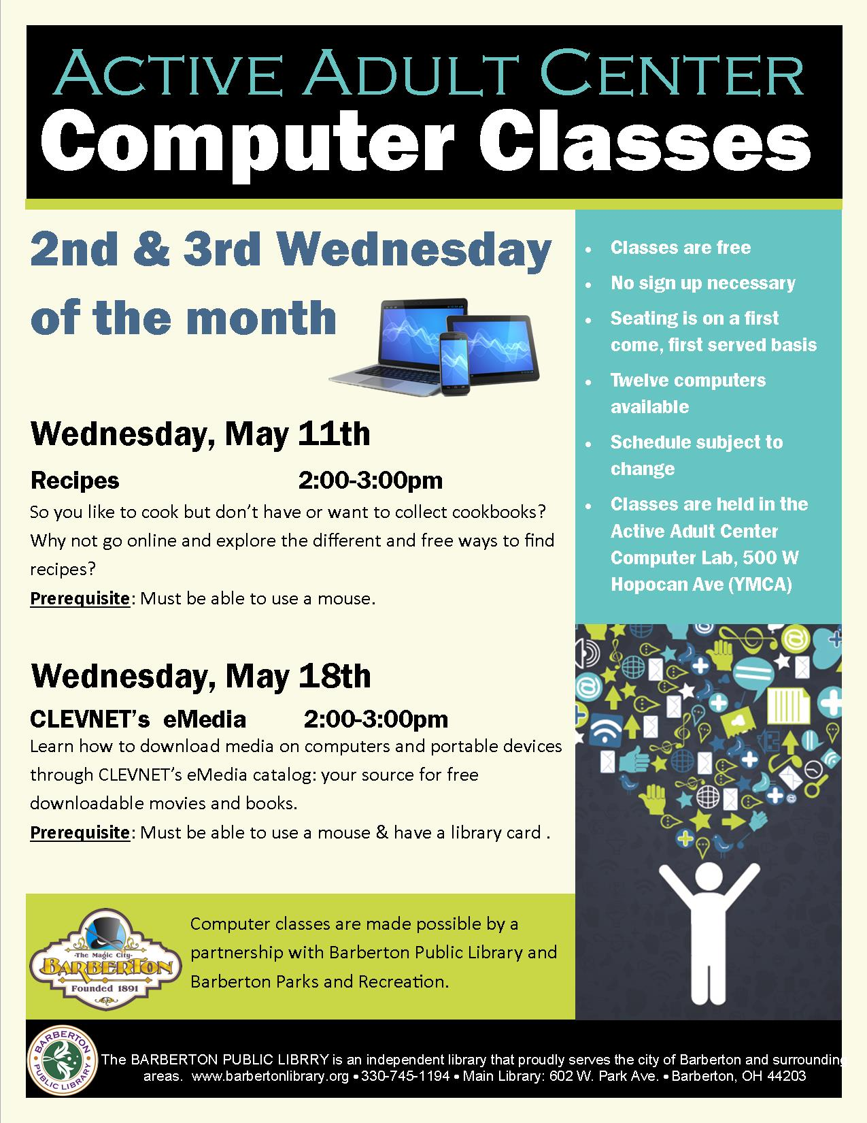
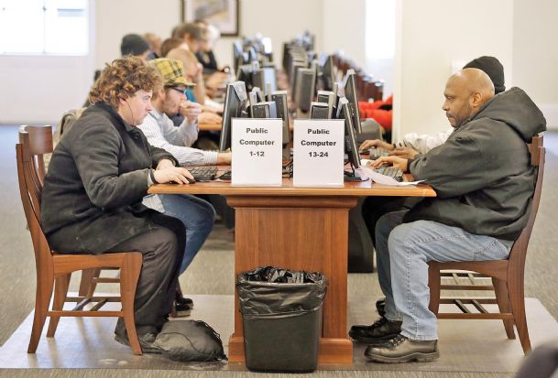
Client: The Public Library
Notes:
Pre click:
Transition
First Click:
Has a large proportion of inexperienced computer users Use computers in a time sensitive manner
Next Click:
Wants Speed up ability to type on browsers An intuitive format reminiscent of phones Cleanly incorporate into browsers Filter profanity

Slide 4

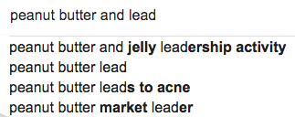
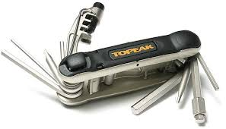
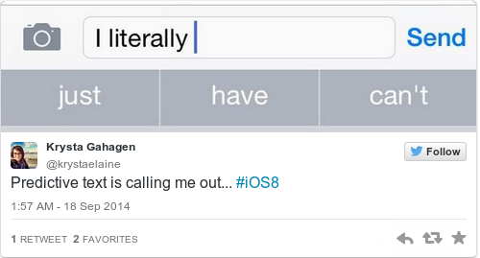
What we will achieve
A multifaceted typing assistant
Notes:
First Click: Predict the Next Phrase
Next Click: Predict the next word
Next: Import into browsers
Next: Add Tools as needed
Next: To Crate a

Slide 5
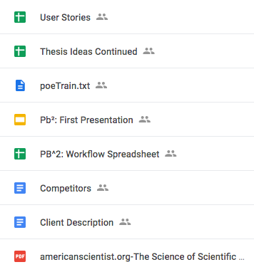
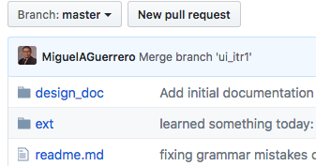
Recording and Repository
Notes:
First Click: Google Drive Spreadsheet to track decision Presentation and report files Easy to perform small edits
Github Code and other related files Version control

Slide 6
Back-End Overview
2 Parts:
Word completion - as user typing a word, predict what the word is likely to be
Next word prediction - as user finishes typing a word, predict what the next word is likely to be

Slide 7
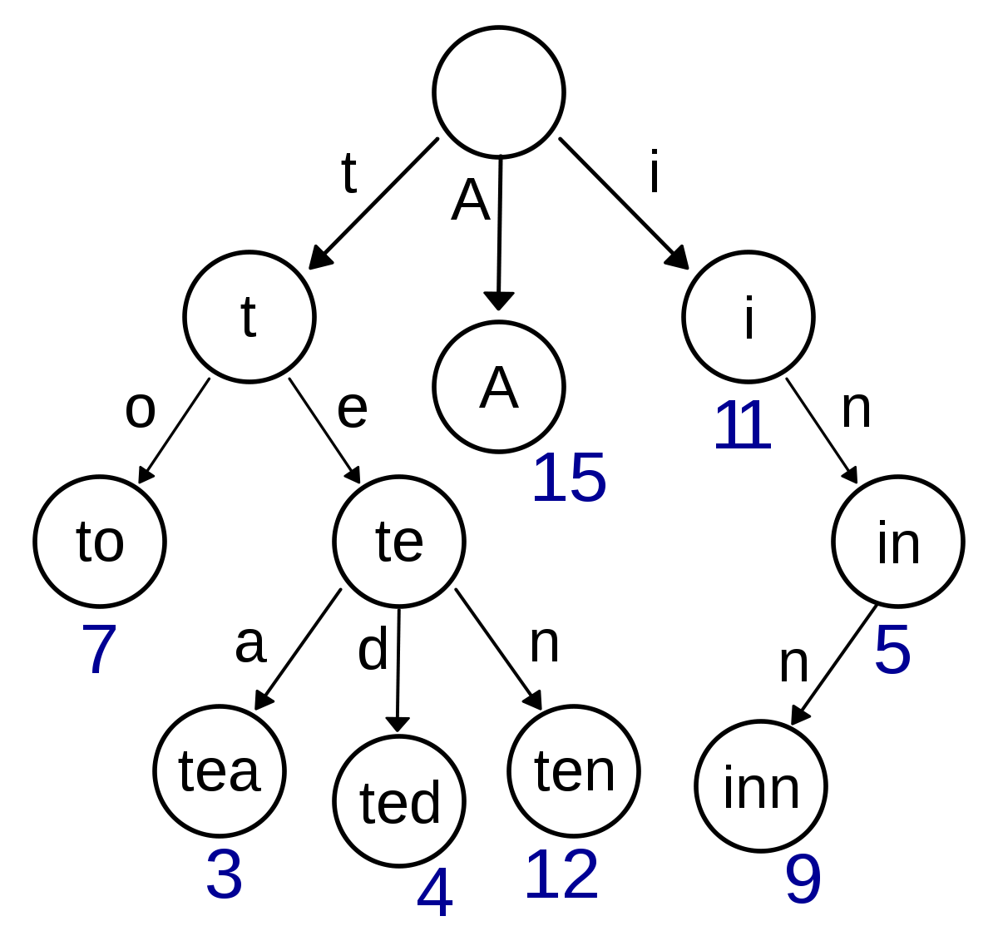
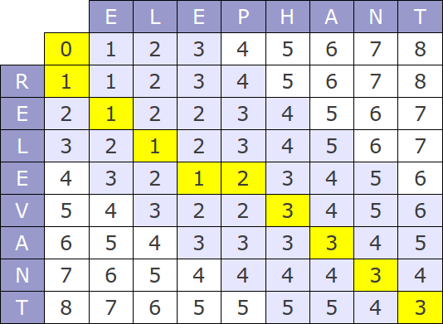
Current Word Completion: Levenshtein/Trie algorithm
Notes:
Explain Trie.

Slide 8

Technical Details (Backend)
Next Word Prediction: Recurrent neural network
Notes:
Explain RNN what it does?
We use a RNN that takes a sentence, and remembers the context of the sentence to predict the next likely word
We have the means of predicting words with our algorithms, so how do we present this information to the user?

Slide 9
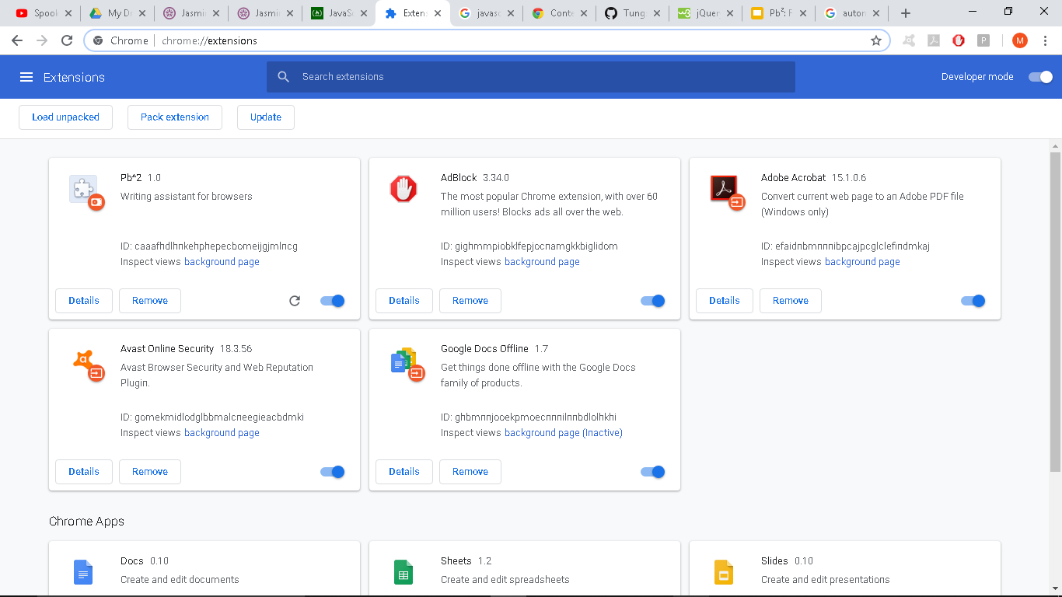
Notes:
We need to make a plugin.
In order to use this logic, we have to use a plugin, which is extra functionality added to a browser.
What does this mean?

Slide 10



Frontend
Notes:
In order to provide a writing assistance for browser we had to adhere to the chrome extension arch. which emphasizes the use of html, js
Which is nice bc the algorithms we’re using can be easily repr as code on the client side
What is the benefits of using Chrome env? Give us mean to provide visual output for the algo.s .and providing UI experience in the process.
Now that we can provide the logic to the client we want to test that the functional works? So we use Jasmine
The testing framework in use is Jasmine

Slide 11

Frontend: Testing
Notes:
Jasmine testing frame work
Is Behavior Drivien Development oriented
Helps test JavaScript
Jasmine was easier to integrate than other frameworks (Mocha, Jest, etc.)
-----------------------------------------------------------------------------------------------------
Start Here:
We use Jasmine bc it’s easy to use, easy to integration in our model
And it had friendly feel for our clients,
who can easily read and understand the behavior of the tested function
Can be convinced that it works

Slide 12
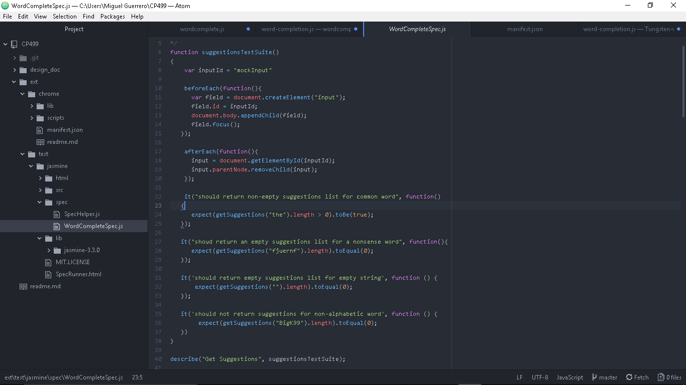
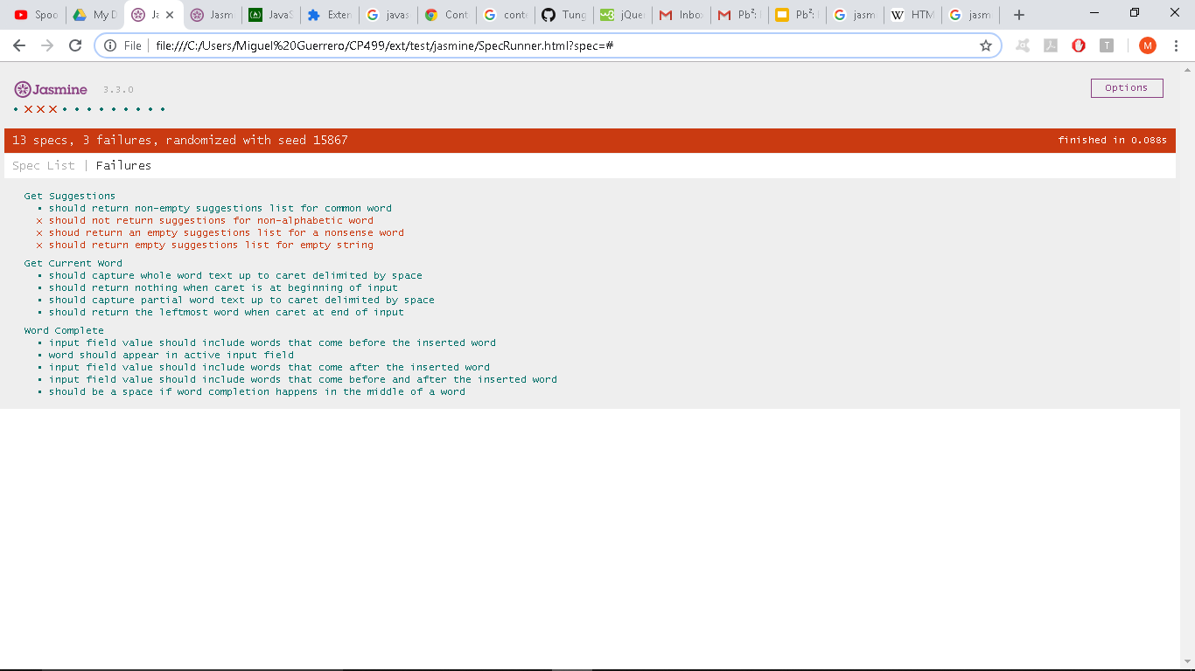
Frontend: Testing
Notes:
Features of the extension can be represented as tests
Each test represents a behavior of the app that can be easily understand by the client
Keeps us more focused on client’s need
Selenium for automated browsing?
Verify that models works
Important when we change models, which is expected
Highlight the fact that the test failed upon changing models and that this is why tests are useful

Slide 13
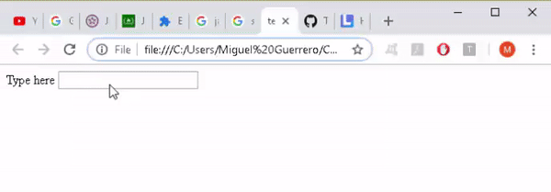
Demo
Suggestions are shown as users type
Notes:
Miguel Guerrero Tutorial
Suggestions are shown. It shows the closest 3 correct words.

Slide 14
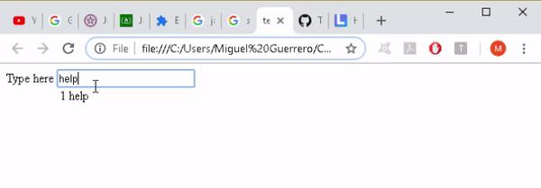
Demo
By pressing the displayed shortcut,
users can complete their words with the offered suggestions
Notes:
Pressing the number 1 can finish the word

Slide 15
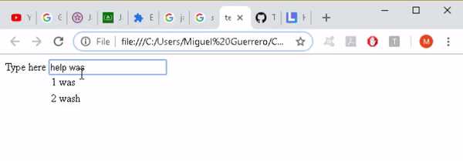
Demo
Suggestions are based on text up to the input cursor, delimited by whitespace
Notes:
Correct words in the middle. This expedited spelling changes

Slide 16
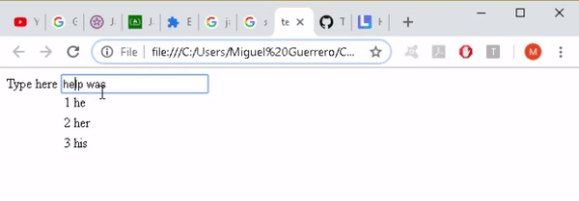
Demo
Word completion performed in the middle of text separates the trailing text with a whitespace.
Notes:
Currently

Slide 17


Challenges
Frontend
Backend
Notes:
Modules: The local modules are not the same as the Chrome modules: It's programming without being able to use imports
For Example: In current Incarnation
Oh tenser Flow. You are so strong. But much like the body builder in a horror film. Your just too big to make the cut. We spent many cold nights with you

Slide 18


Plan & Goals
Week 1: fully integrated front and back end with both models
Week 2: client required features: profanity filter, erase search history (non-personalized), customizable word set
Week 3: polished final product, more models with greater capabilities
Notes:
A full set of goals can be Found on the google drive
Week 1 - fully integrated front and back end: We have two puzzle pieces that don't quite fit together. We need to sand them down until they fit.
Week 2 - client required features (profanity filter, erase search history (non-personalized), customizable word set)
Week 3 - polished final product, more models with greater capabilities. The goal of this project is to be easy. And you have spend a lot of hard work to make something feel easy.
I

Slide 19
TabX: 2.1
Writing assistant plug-in for browsers
Notes:
Quick Project Topic Reminder
What we are: Writing assistance in the browser
Finalized product name: Pb2 -> TabX
Reason: Name was more inline with actual project

Slide 20

Our client
Notes:
Pre click:
Transition
First Click:
Has a large proportion of inexperienced computer users Use computers in a time sensitive manner
Next Click:
Wants Speed up ability to type on browsers An intuitive format reminiscent of phones Cleanly incorporate into browsers Filter profanity

Slide 21


Status Update
Front-end
Created an interface with the backend
Integration of models
Back-end
Implemented/improved functional word prediction & completion models
Challenges
Conforming to Chrome
Notes:
Quick Status Update: Take a couple minutes to briefly describe accomplishments, changes and new challenges since the last presentation.
General
Allowed Node.js libraries to be used in development and testing
Using webpack for deployment
Makes managing dependencies easier
Encourages modular code
Front-end
Made it more flexible: decoupled UI / app logic from browser specific stuff
Created an interface with the backend
Allows models to be swapped around with worrying about
Implementation details
Back-end
Improved word completion model (trie)
Two functional word prediction models
New Challenges
Conforming to the Chrome browser environment
Integration and webifying the models
Having an already trained model (not trained in deployment)
Dependencies can work in browser
No fs

Slide 22
Front-end Plan
 | Presentation 2.2 | Presentation 3.1 | Presentation 3.2
Khayyon | Create the another display method for suggestions as a bar instead of a table Improve accessibility by developing means to set font size and color of suggestions and how they presented | Refactor/remove accessibility features and UI display methods based on UI feedback Apply filters to what text fields we do not want the extension to provide suggestion/predictions (password fields) Create UI logic as needed for other writing assistant services | Bug Hunting Update and finalize README.md file in the repo
Miguel | Polish up tabular suggestions display for word completion for consistent display across different websites Create UI logic for word prediction and make it seamless with UI logic for word completion | Refactor by removing duplicate code, consistent styling, and creating more modular scripts, each with a single responsibility. Create settings for TabX to allow users to pick what writing assistant services they want | Finalize instructional material on how to use TabX General code cleaning and documentation
Notes:
Overall: Front-end will be working heavily to implement new features and make sure that these features are accessible to the users and provide an overall great user experience
KHAYON: Create another display method
Miguel: Polishing up the UI across the iterations of the project, maintaining system design, and creating an instruction manual

Slide 23
Back-end Plan
 | Presentation 2.2 | Presentation 3.1 | Presentation 3.2
Mishig | Polish JS API to the word prediction model Integrate word prediction model with front-end | Optimize word prediction model inference speed Train word prediction on bigger and more relevant dataset | Refactor and test If time left, try for a stretch goal: new feature
Nicole | Integrate training for word prediction & completion models Add ability to customize word suggestion set Help organize user testing | Implement abbreviation expansion model and profanity filter Modify back-end models based on feedback from user testing Help gather feedback from user testing | Polish & fully integrate all back-end models with frontend Clean up code, update documentation
Russell | Integrate training for word prediction & completion models Incorporate metrics for user testing & organize user testing | Polish word completion model User testing & gather feedback Potentially implement an autocorrect feature | Polish & fully integrate all back-end models with frontend Clean up code, update documentation
Notes:
Overall: Our plugin must work in realtime. Hence, our predictive models must be fast. Overall, we will be optimizing and testing our models for this week. Sepcifically,
Mishig: Optimize word prediction speed, by reducing various components of the model.
Nicole: Maximize both the Accuracy and Efficiency of the word completion model.
Russell: Create and optimize a Method for testing how good our system is.
Will be working on validation of the models. Basically, making sure that these models actually work and do correct thing.

Slide 24
Architecture and Specifications

Slide 25
Users Stories
As a person who makes frequent spelling mistakes, I want to be able to have spelling corrections suggested to me, so that I may type more accurately.
As a technologically challenged user, I want the suggestions to be presented in a tabular format, so that I can understand what my options are.
As a slow typer, I want to have suggestions for the word I am typing, so that I can write more quickly..
As a layman writer, I want to have suggestions for what the next word would be, so that I can quickly type common phrases.
As a user, I want to be able to manually toggle between horizontal and vertical options for spelling corrections, so I can customize the app to my preference.
As a user, I want to be able to turn the application on and off, so that I can easily customize my browser experience.
As a user, I want to be able to change the font size so that I can clearly see the text and suggestions.
As a user, I want the recommendation font to be the font that is being typed.

Slide 26
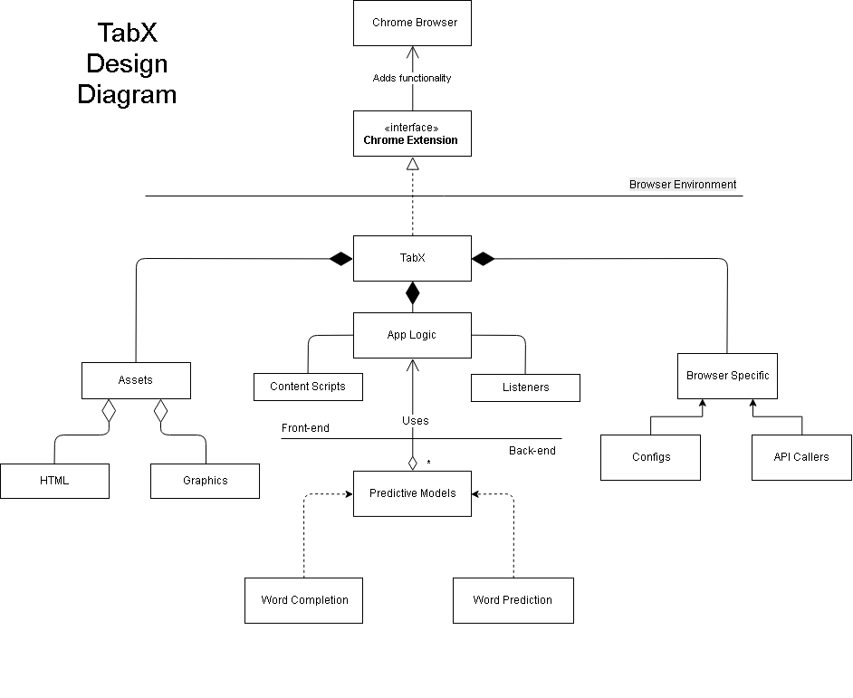
Notes:
System design is important because we have to consider different writing assistant services
We ask, “how we create a system where we only have to add code for each feature, with minimal modifications?” AKA extensibility and flexibility
A solution is to decouple as much of the subsystems as possible
These subsystems were developed with the above question in mind
The current design allows
easily swap out different modules as needed because we coded to an interface, not an implementation of anything specific
Subsystems can be developed in parallel and independently (makes git SOOO good… no/little conflicts)
Overall TabX has flavors of the MVC architectural design pattern, where how information is displayed, data and data logic, and how users interact with this data have minimal (if any) dependencies on each other.

Slide 27
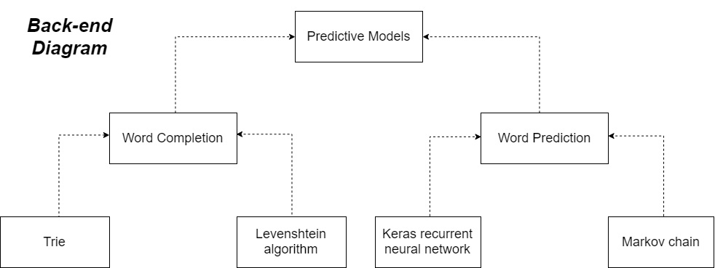
Notes:
Interfacing between the front-end and back-end allow different implementations to be used for writing services
There are several implementations we have now
Each implementation has a single responsibility (appealing to interface)
Can be developed independently from each other
Each can be integrated into TabX without changing application logic
Really great for testing :)

Slide 28
User stories and Mock UI
I went to the |
Helo|
Helo|
1 | movies
2 | store
3 | mall
1 | Hello
2 | Help
3 | Halo
1 | Hello
2 | Help
3 | Halo
As a layman writer,
I want to have suggestions for what the next word would be,
so that I can quickly type common phrases.
As a person who makes frequent spelling mistakes,
I want to be able to have spelling corrections suggested to me,
so that I may type more accurately.
As one who is hard-of-seeing ,
I want to be able to change the font size of suggestions,
so that I can clearly see them.

Slide 29
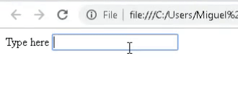
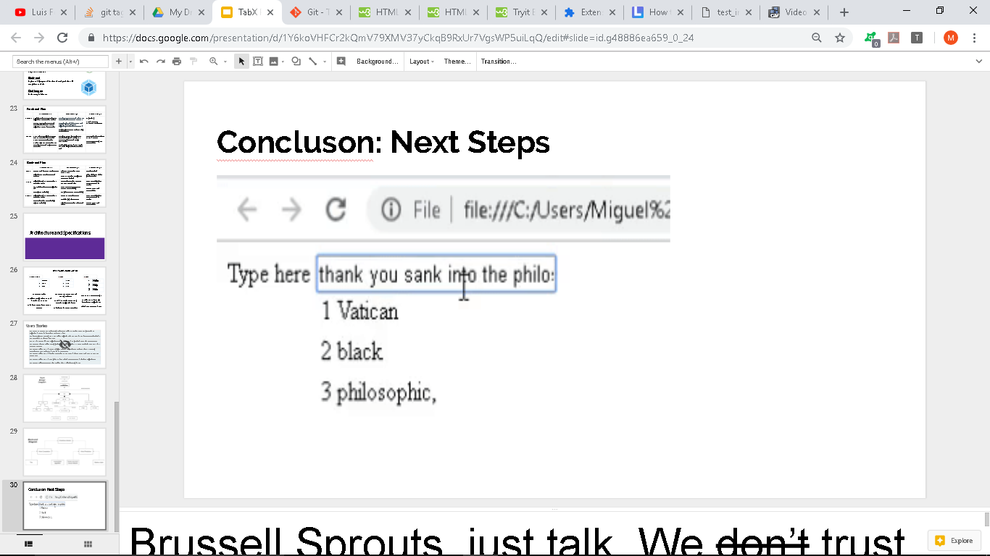
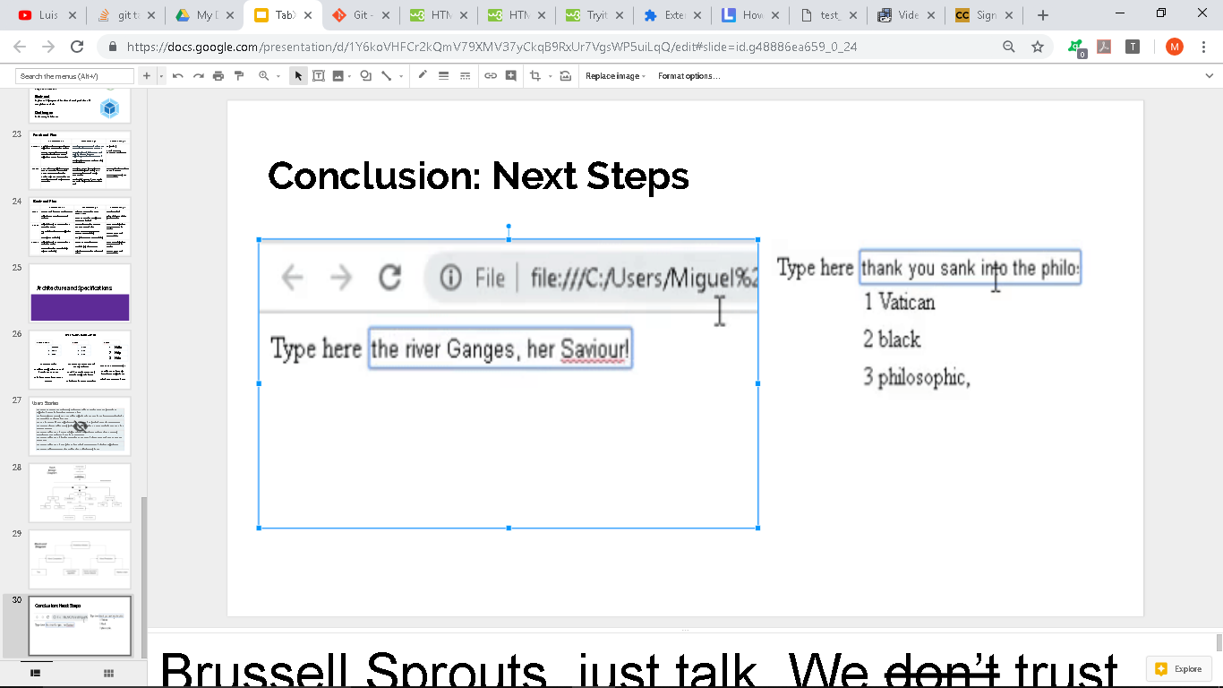
Conclusion: Next Steps
Notes:
Brussell Sprouts, just talk. We don’t trust you.
Impact of Challenges:
Plans:
Specifications: Make Progress by measuring the Success and Failure
We figure the priority of the library is accessibility:
To be more concrete, explain the impact of our new challenges, plans, and specifications in how we will make progress. This is not just a summary, but insight into why we included the things we did
into this presentation.

Slide 30
Our client
Notes:
Reminder our client is a library. The Library wants to aid their users more quickly use the product
Cornodo High School: Russell is Meeting with Donald Moore, a elderly man who works with disadvantaged students. he is both a potential user and has access to a different demographic of potential users.

Slide 31
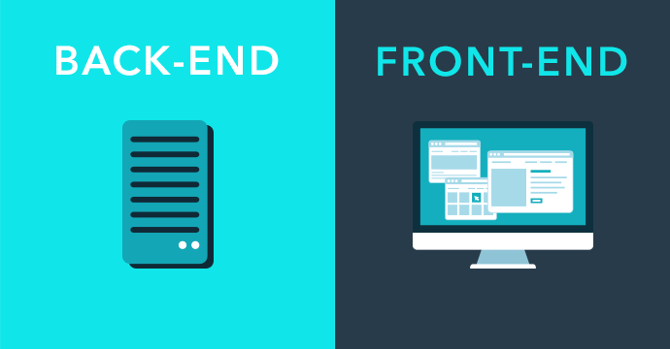
Improvement of word correction, completion, and prediction models
Testing on browser
Consistent display table
Notes:
Front end:
No more mock
set CSS element so that it doesn’t adopt CSS element of given web page so you can see the table
Backend:
Improve models in terms of prediction accuracy (modifying algorithms), speed, and compatibility with interface (input/output)
Challenges: focusing more on user interface appeal
Consistent display - attempt to push table to front of page, figure out default configuration to improve display, other display settings that will be as user friendly as possible
User testing - metrics for gathering both qualitative and quantitative feedback, recruiting users who will fit the library’s target demographic

Slide 32
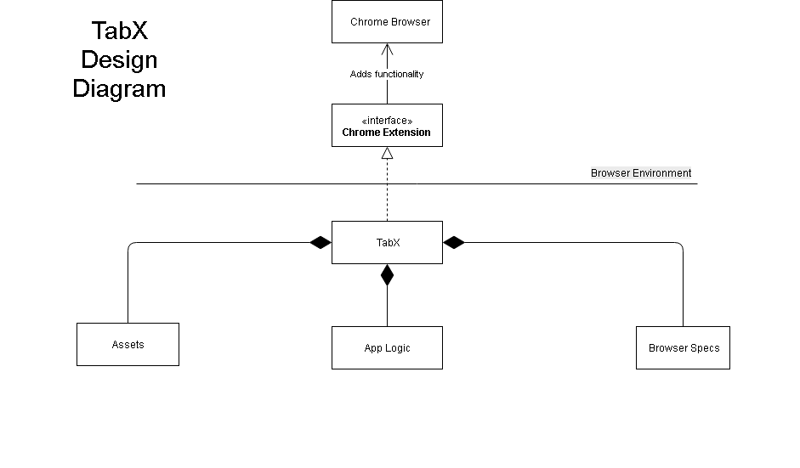
Notes:
TabX is composed of the app logic, assets and the Browser Specs to adhere to the chrome interface
Today I will be discussing the major subsystems of tabx in the event that our whole team get annihilated by that ‘bus’ aka considering the bus factor in our design

Slide 33
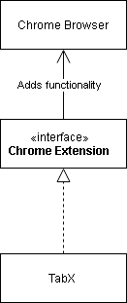
Responsibility | Purpose
Defines the “responsibilities” and “constraints” of TabX and how it and its subcomponents should operate to work within Chrome | To deploy TabX into Chrome as client wants
Notes:
The Importance OF THE INTERFACE BETWEEN our app AND THE CHROME BROWSER IS DEFINING CLEAR TASKS & LIMITATION ON HOW TABX SHOULD WORK WITH IN CHROME
IT ALLOWS US TO DEPLOY THE APP TO CHROME LIKE OUR CLIENT WANTED

Slide 34
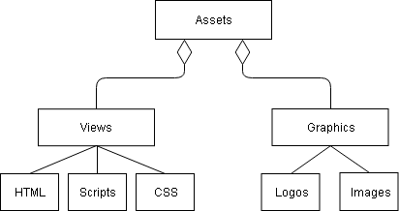
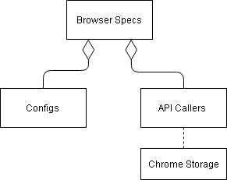
Responsibility | Purpose
Decouples presentation from the application logic | To better create views for UI-friendly interaction between TabX and the library’s non-techy users
TabX’s delegate for interfacing between it, browsers and their APIs | Anticipate deployment in other browsers (aka just-in-case)
Notes:
The Assets Subsystem, have views that separate the design/style of extension from the logic
This allows us to create more stylized views to enhance the User Exp. for non-techy library patron
The Browser Specification System, contains browser-specific configurations files and an API Caller interface
The significance of this system is that it will allow us to deploy the app in other browsers with ease

Slide 35
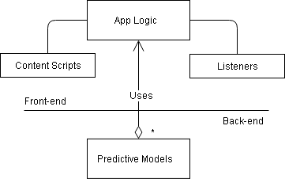
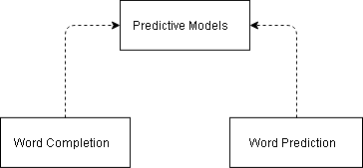
Responsibility | Purpose
Handles UI and service provision | To enable the client’s patrons to access TabX’s writing assistance features
Produces suggestions based on user input | To ensure writing assistance features produce results that users would want to use
Notes:
Responsiblity of the App Logic: It repr how tabx provide USER inTERACTIVITY GETTING USER INPUT, PROCESSING IT
(CONTROLLER IS UNDER APP LOGIC & USU CONTROLLER IS SEPARTED)

Slide 36
Responsibility | Purpose
Offers suggestions on how to finish an incomplete word | To service our client’s patrons with writing assistant features as specified
Offers suggestions on what words should follow a complete word

Slide 37
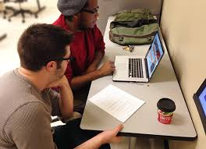
Validation Testing
Qualitative: What do you think?
Usage: How often?
Correction: How accurate?
Speed: How fast?
Notes:
Meet with Users We want to see what people think. I'm meeting my elderly friend who works at Cornodo.
3 tests:
Usage out of 100 words how often
Correction: How often do our proposed corrections match with actual
Speed: How fast with and without aplications.

Slide 38
Example/ Demo

Slide 39
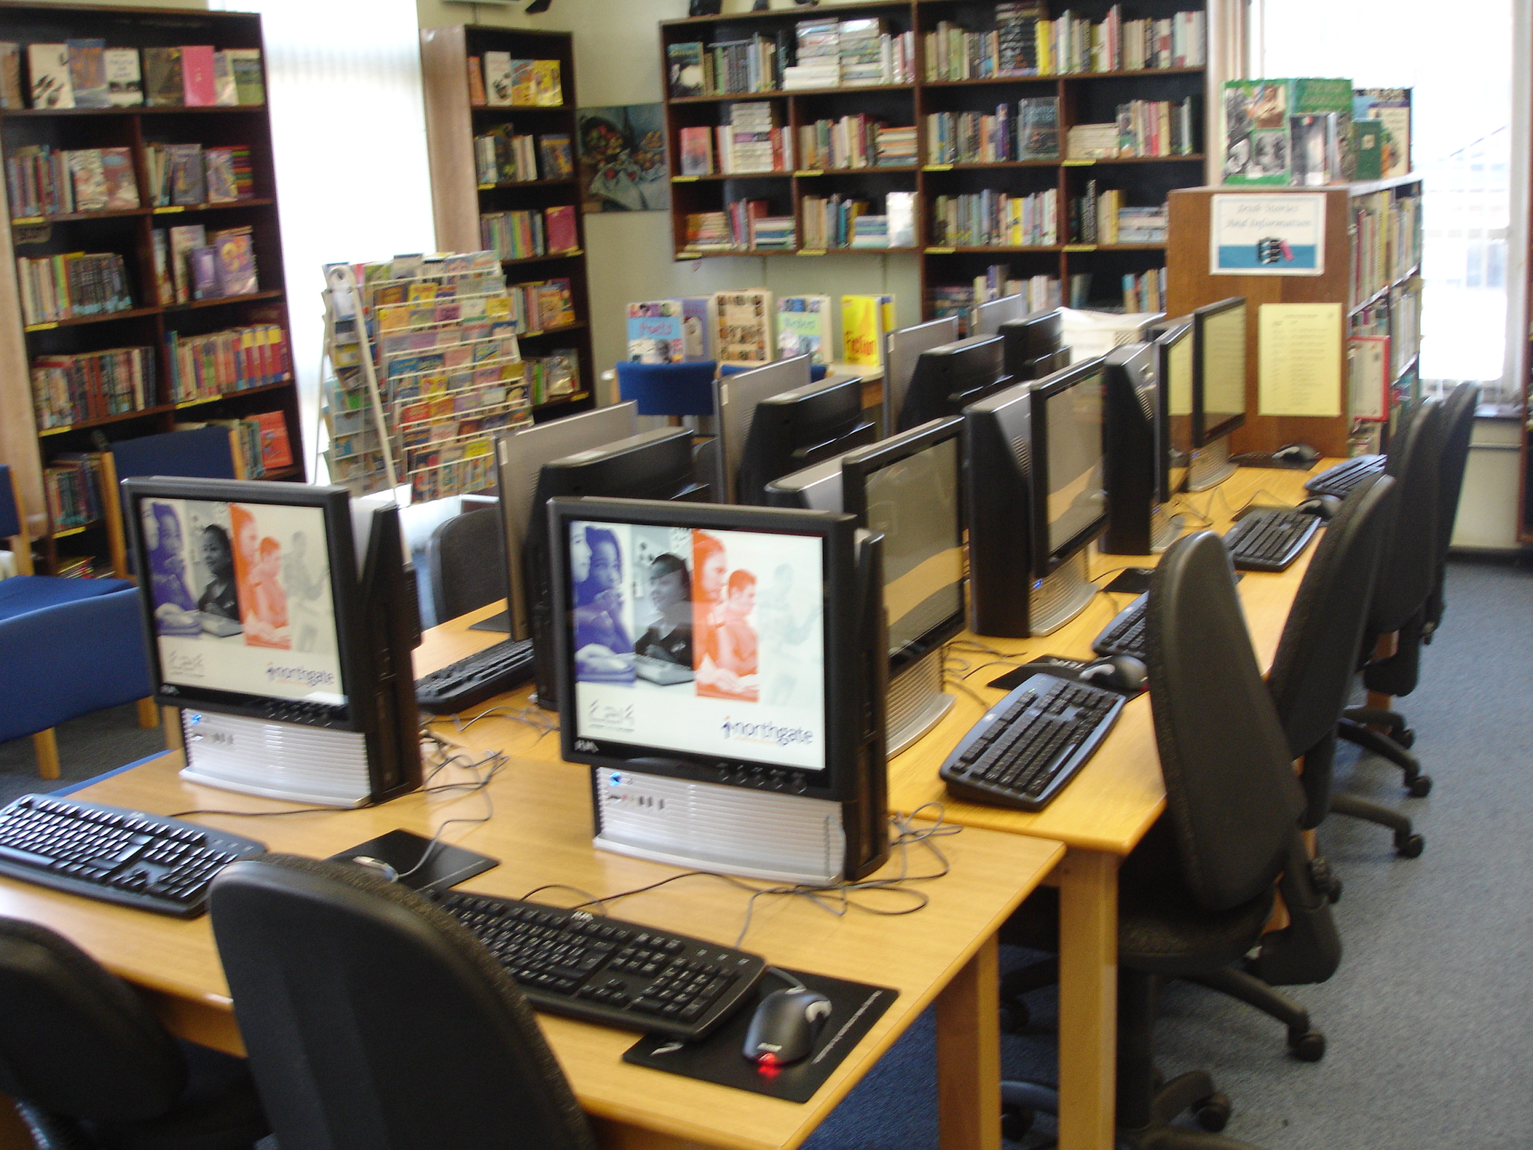
Our client/ Updates
Notes:
Reminder our client is a library. We had initially been thinking about public Library.
After Talking with Donald Moore, we're not under the impression that It's not just adults that have problems. This is a very teenage problem.
Maybe a generational difference. But typing is not the same as inputting. A generation may fooled into thinking this is assistant for type writers.
Students don't have typing classes and are often just expected to know how to input. Instead they learn how to hunt and peck because they type like using a phone.

Slide 40
Upgrading models
Validation tests
Settings tab
Updated display table
Notes:
Front end:
Settings - actually functional now, turn features on/off
Restructured architecture - had to make async - models only load once at start of program, user interface loads every time
Updated display table - made more consistent, now can be horizontal bar
Backend:
Improving word prediction and completion/correction models
Validation tests for backend models
Challenges: presentation and quality aspect - how to validate
Non-ugly user interface
User feedback

Slide 41
Architecture / Specification Update

Slide 42
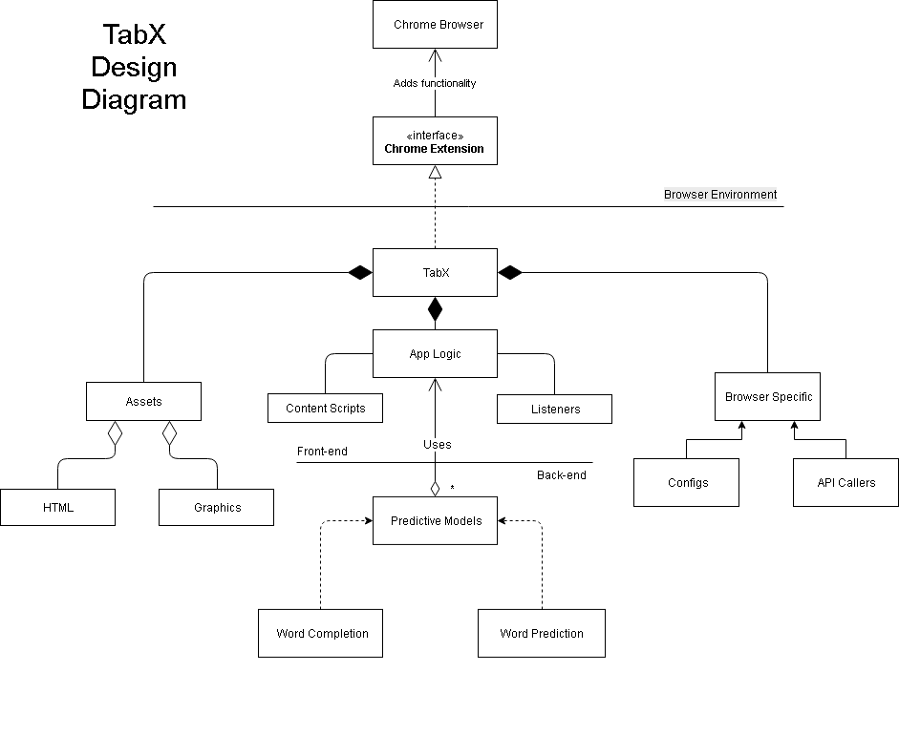
LAST ITERATION
Notes:
OLD DESIGN

Slide 43
NO CHANGE
Notes:
OLD DESIGN

Slide 44
CHANGED TO BE ASYNC
Notes:
OLD DESIGN

Slide 45
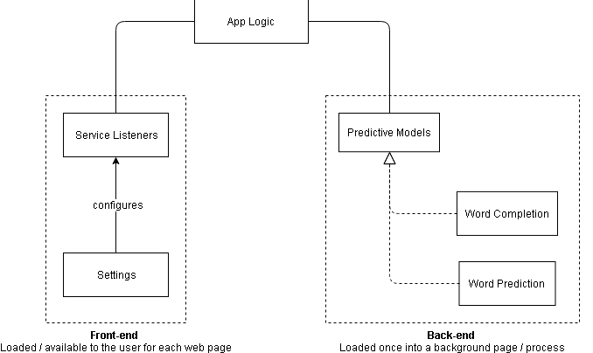
Now
Last Iteration
Settings
All loaded into
EACH page
Notes:
Models are loaded into another page
Previously, models and controllers were loaded into one page unnecessarily
Settings happened externally from the actual webpage (in popup.html)
Communications happened via messaging
Messaging is async
Last iteration was configured for synchronous js
Trying to synchronize async calls is a HARD
Make the app logic async
Also, Chrome API calls tend to be asynchronous, so having asynchronous app logic allows for us to interact make API calls more natural

Slide 46
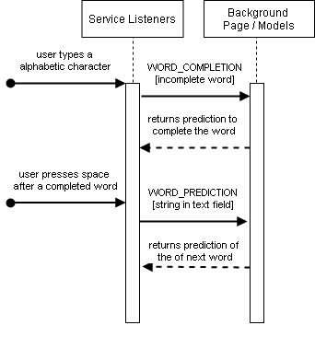
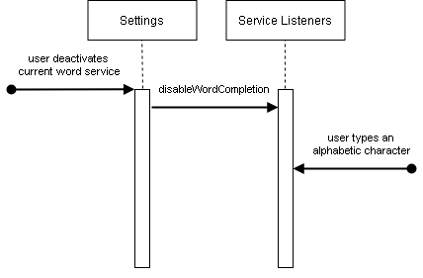
Messaging
Notes:
NOTES: Background is always activated because it’s persistent
Service Listeners do not send message if current word service is deactivated

Slide 47
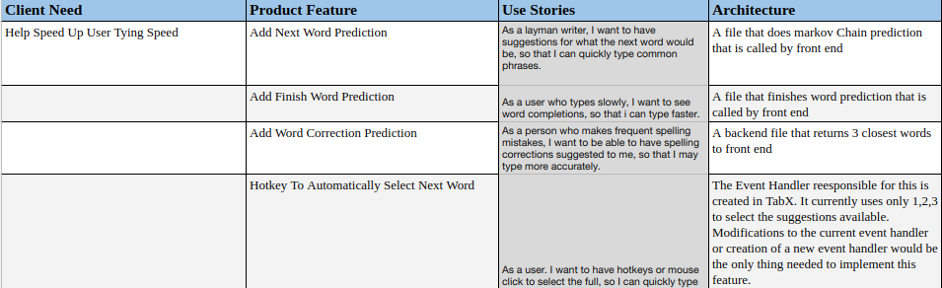
Acceptance tests
Notes:
type speed of users increasing (wpm with TabX vs without TabX)
users actually using the suggestion (how many percent of the time users are using the suggestions)

Slide 48
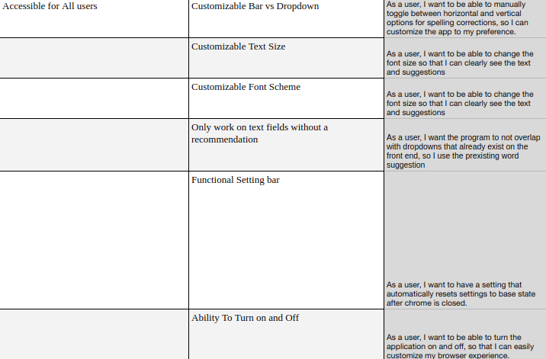
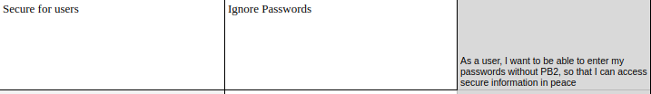
Notes:
is TabX user friendly (see how fast users are picking up TabX and whether they are confused by any details)
are accessibility features actually making TabX accessible?
is tabX secure? don't ssave password or suggest passwords
Finally, if our client disagrees, here is the document to coentract

Slide 49
Notes:
We no face the gauntlet of User testing. Terrifying

Slide 50
Our client/Updates
Notes:
Very Quick Review

Slide 51
Validation tests
Improved prediction quality
Configuration
Updated settings
Notes:
Front end:
Updated settings - accessibility settings for text display: font, size, color
Configuration - configuring all the new settings and dealing with how they affect the display table
Backend:
Improving word prediction and completion/correction models - bigger datasets to train models on, standardizing for punctuation and capitalization
Thinking of possibly making it so that word prediction learns from user - but this gets erased at end of session? At least make it an option to personalize
Validation tests for backend models - (are they functional? Also quality tests for word completion)
Challenges: presentation and quality aspect - how to validate
Displaying suggestions table across popular webpages
Quality suggestions from models
User feedback

Slide 52
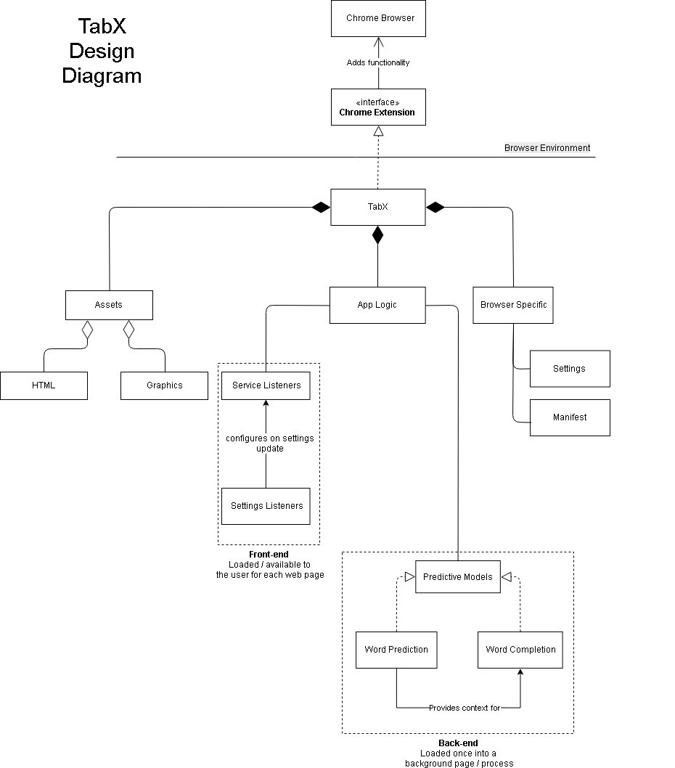
Architecture Update

Slide 53
Architecture Update
Slight Change

Slide 54
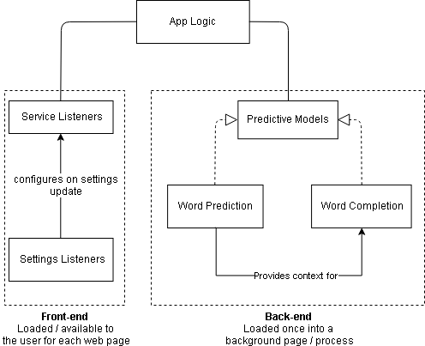
Architecture Update
Previous Iteration
Now
Notes:
OLD DESIGN

Slide 55
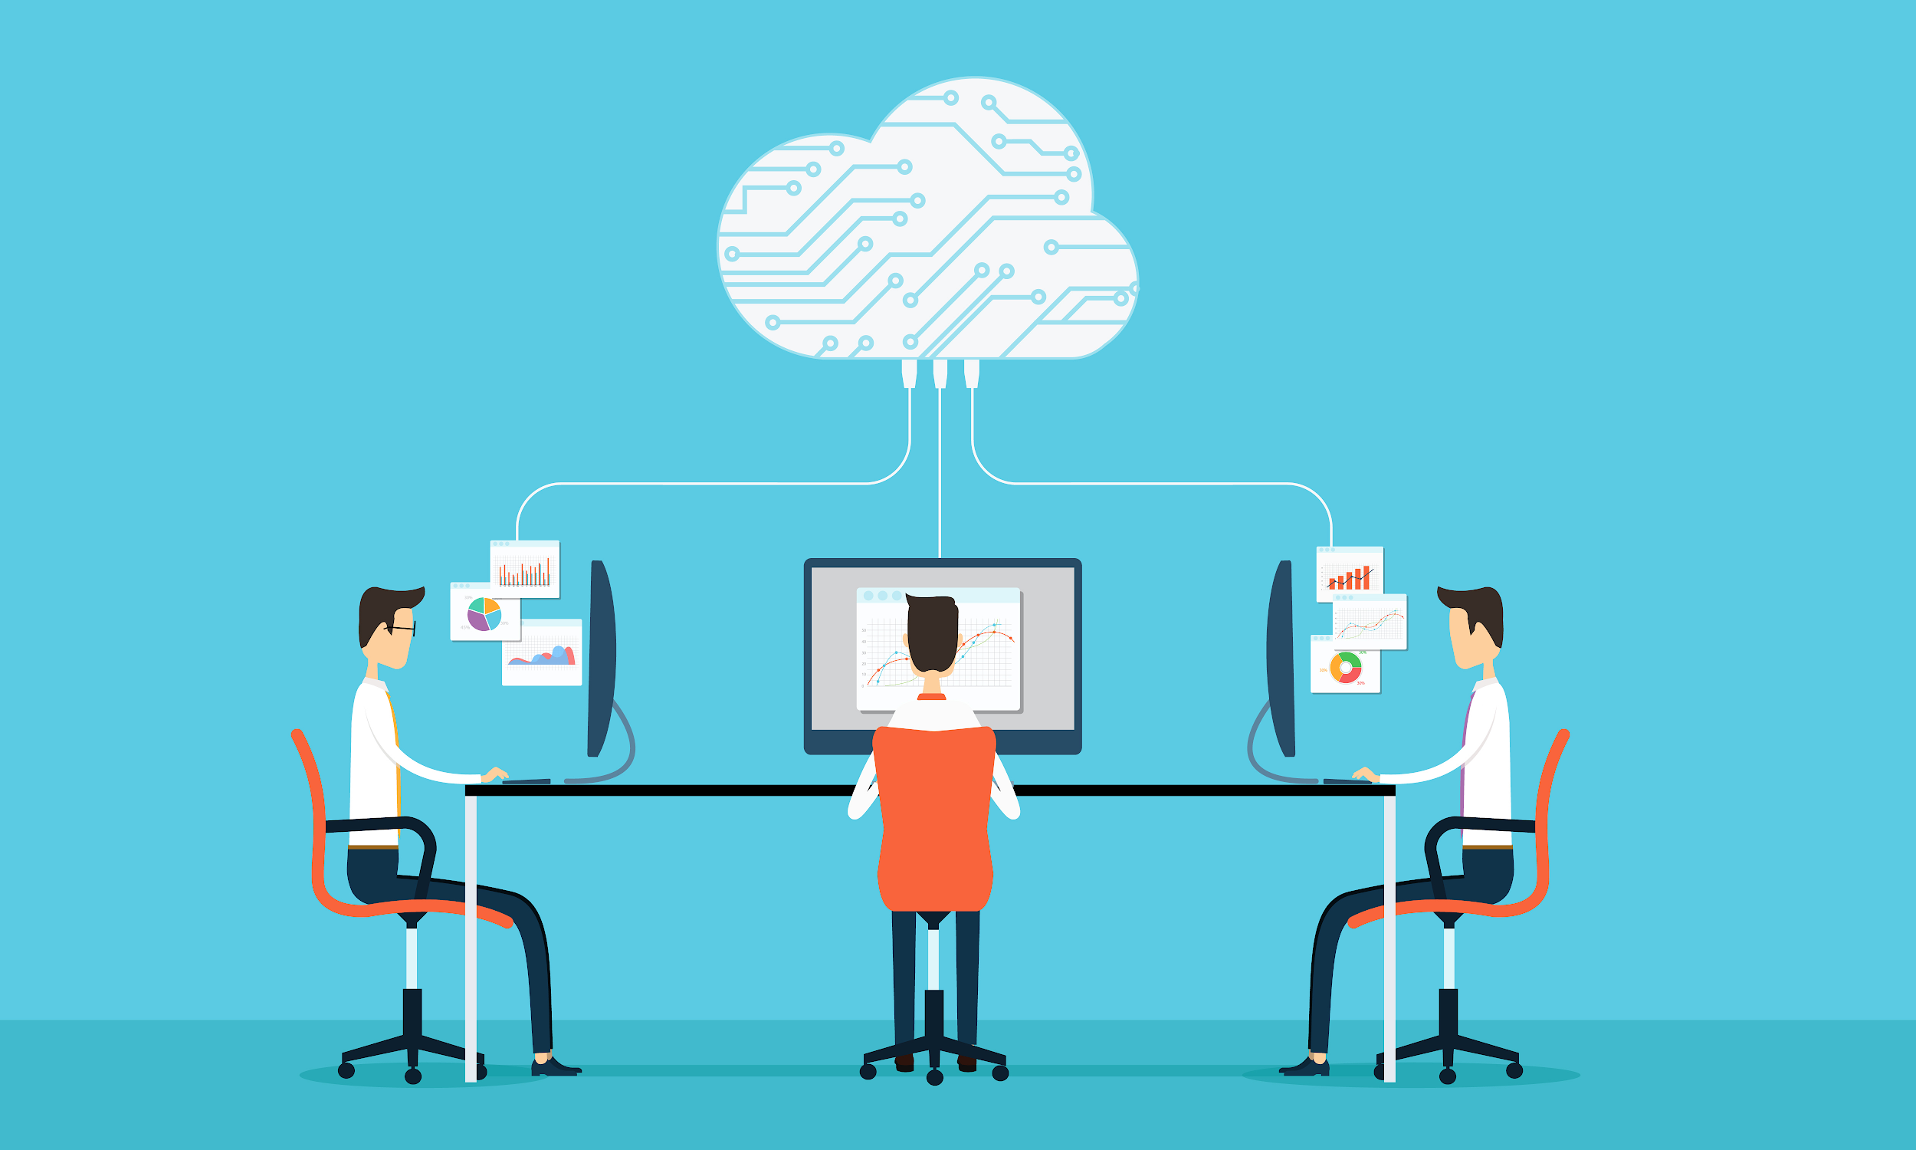

Validation Testing
Front-end Functionality:
21/21 tests pass for functionality (Jasmine)
Back-end Functionality:
All basic tests pass for functionality
Front-end Quality:
Sniff test
Back-end Quality:
Word correction
23% of total words
completed accurately
Notes:
Here are the testing: We have 2 types of tests, Functionality and Quality
Functionality tests are simple. Does this work? All of our Functionality Tests pass. The product does what it's supposed to do
Quality is harder to test. It works but does it work well.
Front End this is difficult. Because we interact with API, we have to see exactly How it interacts
Currently no way to test if something is visible. We have to manually use it on websites
Back end: The Completion tests are All Passing, but the Correction test is terrible. We have to remake model of Correction. Our Goal is to have 50%

Slide 56
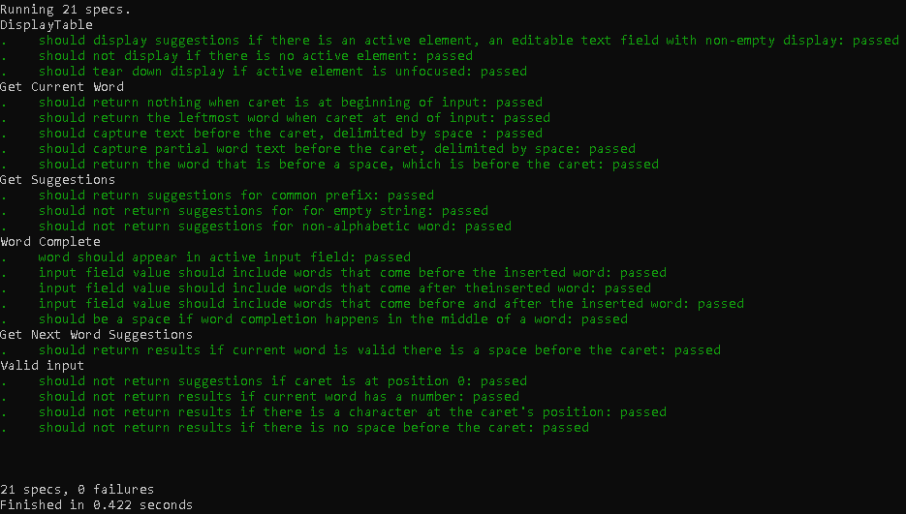
Notes:
Jasmine tests for front-end user interface - 21/21 pass.
Here is an example of a test completely passing front end

Slide 57
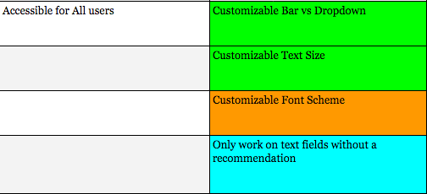
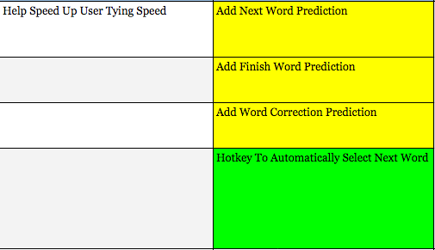
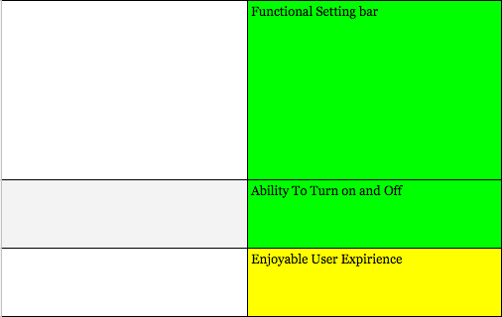
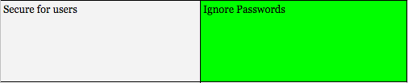
Project Adjustments

Slide 58
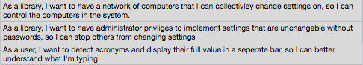
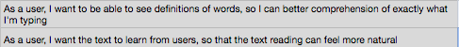
Icebox/Stretch Goals

Slide 59
Notes:
We no face the gauntlet of User testing. Terrifying

